Slide 1
PPC cement for sustainable future
By Arvindh
SRM IST Ramapuram

Slide 2
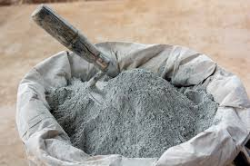
Introduction
New type of ppc cement
Change in raw materials,machienary

Slide 3
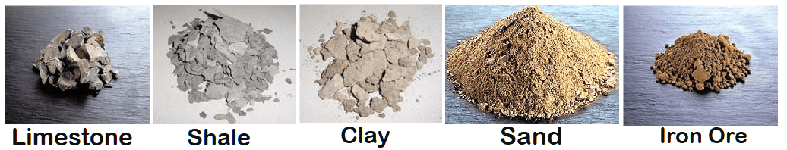
Raw materials
Clinker (70%) → Limestone (52%), Clay (10%), Iron Ore (2%)
Pozzolanic Materials (30%) →
Fly Ash (12%), Rice Husk Ash (6%), Sewage Sludge Ash (4%), Glass Waste (5%), Construction Waste (3%)
Nano Titanium (0.2%) → Strength enhancer

Slide 4
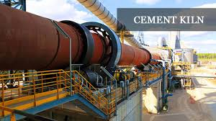
Fuels in kiln
Coal (50%) – Reduced reliance
Plastic Waste (20%) – Utilization of non-recyclable plastic waste
Tyre Waste (15%) – High calorific value
Biomass (15%) – Renewable source

Slide 5
ROLE OF AI,IOT IN INDUSTRY MANAGEMENT
RAW MATERIAL SOURCING:
IoT
GPS-enabled smart trucks, conveyors, and loaders give live data on limestone extraction.Sensors in the mine measure blast efficiency, haul road condition, moisture in limestone.
AI
Predicts the best blasting pattern to reduce oversize boulders.
Real-time inventory prediction of limestone, slag, glass waste, gypsum.Optimizes truck routes and reduces fuel by 10 percent
Result
Continuous material flow, lower cost/ton, and stable raw meal quality.

Slide 6
Raw Meal & Additive Proportion Control
PPC needs Clinker (70–80%)Fly ash or pozzolanic material (20–30%)
IOT:
Weigh feeders, belt scales, online elemental analyzers (XRF/XRD) feed live composition data.
AI:
AI Automatically adjusts the:Pozzolana additionGlass waste + slag %Iron ore + aluminium can wasteNano-titanium 0.1%AI algorithms maintain stable LSF, C3S, C2S ratios, ensuring strong OPC base for PPC.Result: Higher strength PPC with uniform fineness and controlled reactivity.

Slide 7
CLINKER KILN
IoT
SensorsTemperature sensors (preheater → kiln → cooler)Fuel flow meters (biomass + coal mix)Vibration & torque sensors on rotary kilnOxygen, NOx, CO analyzersKiln camera for flame
AI
AI kiln controller keeps:Kiln speed optimalFlame profile consistentAir-fuel ratio perfectClinker free-lime optimalAI predicts:Ring formationCoating thicknessRefractory wearHotspot formation
This reduces shutdowns by 20–30% and fuel consumption by 5–10%.

Slide 8
GRNDING UNIT OPTIMIZATION
IoT sensorsMill vibrationMotor powerFan airflowSeparator speed
AI
Autonomous mill control adjusts:Gypsum blendingSlag/glass waste %Fly ash feedSeparator RPMMill feed rate
AI ensures:
Blaine fineness optimized
No over-grinding
Low kWh consumptionEnergy cost drops 8–12%.

Slide 9
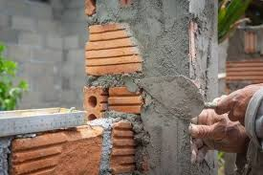
QUALITY CONTROL USING ML
ML models predict:
28-day strength from 1-day strength
Setting time based on fineness + additives
Soundness issues before they appearAI gives early warnings so product failures never reach the market.

Slide 10
LOGISTICS
IoT
Smart weighing systems
QR/ RFID coded bags Truck tracking
AI
Predicts cement demand per district Optimizes truck routing
Reduces freight cost Detects tampering or overloading

Slide 11
PREDECTIVE MAINTANENCE
Predictive Maintenance (AI-driven):
Kiln drives Crushers VRMs
AI analysis :
Vibration patterns
Thermal signatures
Current load
predicts failures 15–20 days before happening.
Saves 20 to 30 rupees per tonne

Slide 12
Power sources
Powering the Vertical Clinker Kiln & Vertical Ball Mill using;
Solar Power (40%)
Wind Power (30%)
Waste Heat Recovery (WHR) (30%)

Slide 13
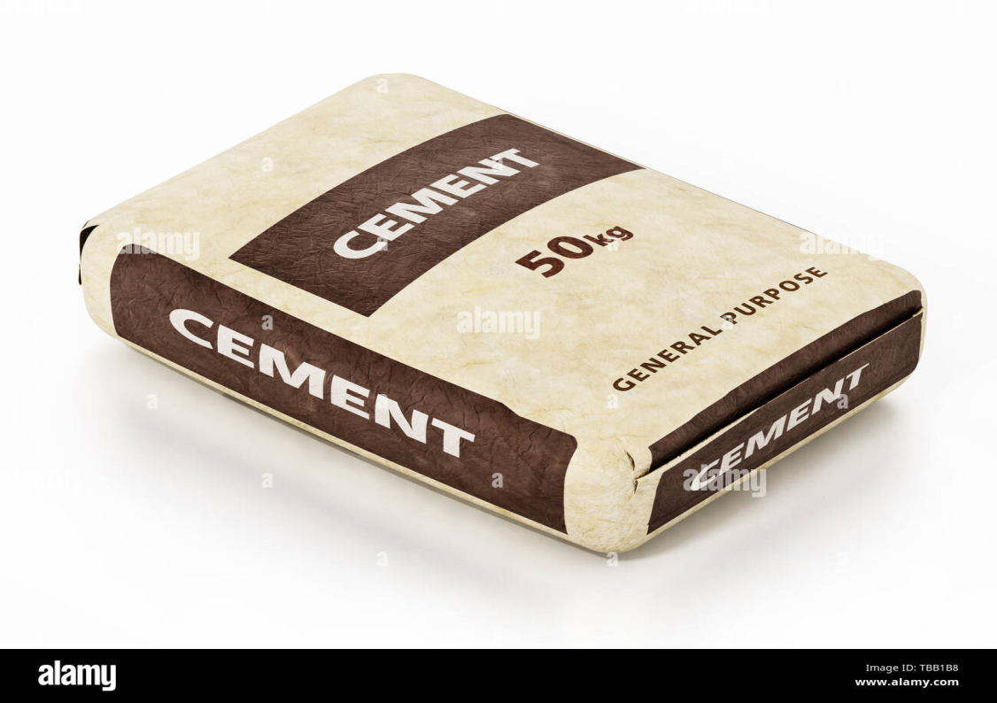
SUSTAINABLE PACKING
Packing with recylcable paper bags

Slide 14
Scope of project
Reduces 30 to 40% of co2 and create circular economy
Improves strength ,durability and shelf life of product
Reduces carrying load due to sustainable packing

Slide 15
Conclusion
This project redefines cement manufacturing by integrating sustainability, innovation, and profitability.
Future scope;
Carbon capture technology
Ai and automation for smart manufacturing

